Slide 1
Weekly meeting
1 18 2024
Ty Bottorff

Slide 2
Outline
Cell abundance results
Patient bias plots for colitis dataset cell type abundance differences by irAE group
Colitis paper cell abundance published results
Airline plots for cell types more abundant in colitis irAE tissue
Convergence density plots
Non-cumulative feature heatmaps

Slide 3
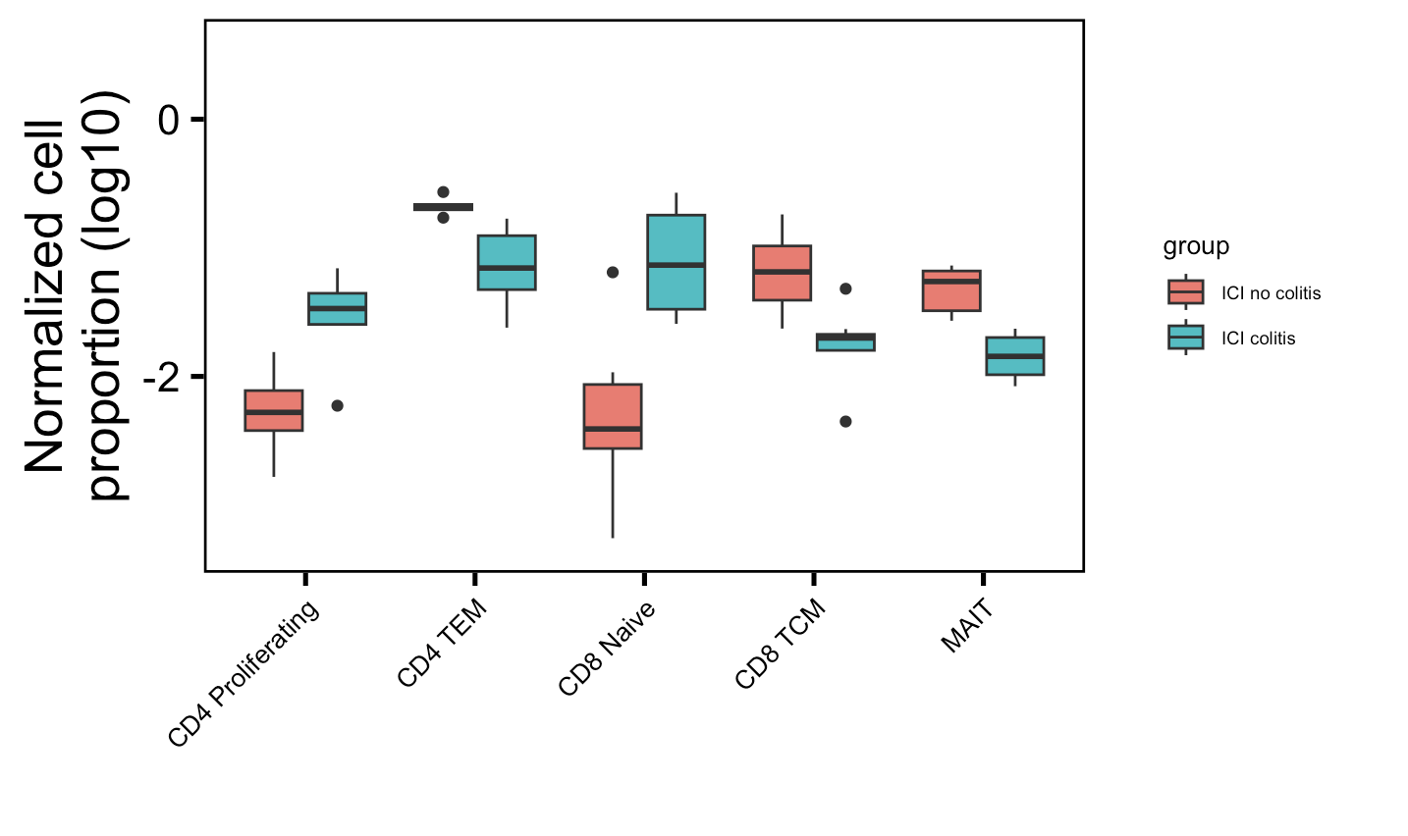
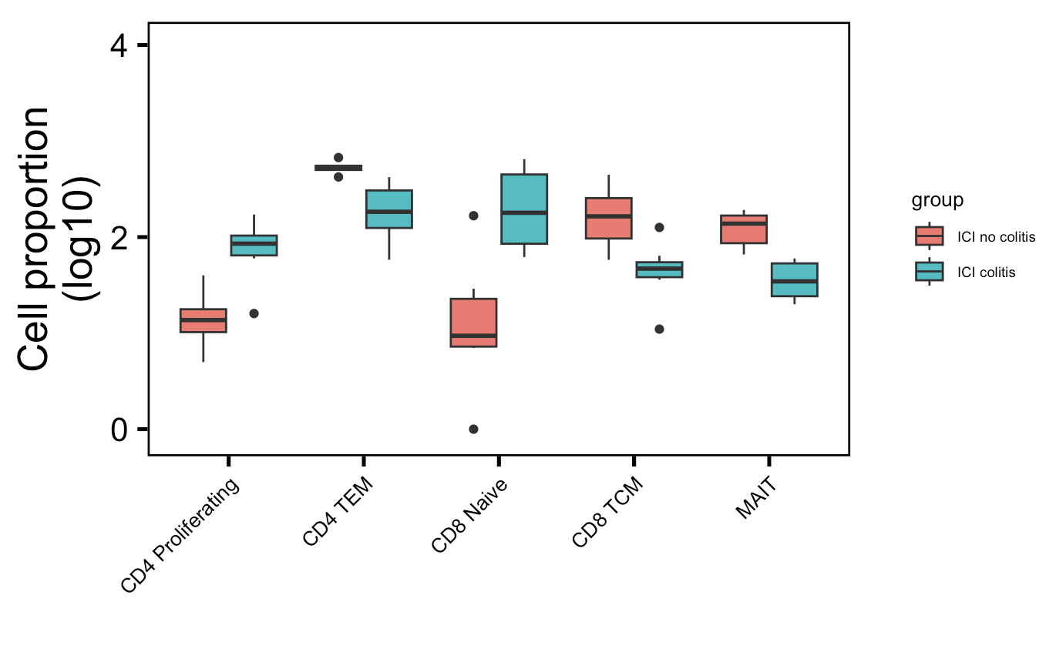
Review of cell type abundance differences in colitis dataset before showing patient bias plots
Normalized by clonotype depth
Downsampled
*
**
*
*
**
*
**
*
*
**
Wilcox rank sum test: **; padj <1e-2, *; padj <0.05
Notes:
There’s only 1 patient in myocarditis dataset that had colitis and had scRNAseq data… not worth looking into anything with n = 1 I don’t think
# padj normalized by clonotype depth
# CD4 Proliferating: 0.01
# CD4 TEM: 0.004
# CD8 Naive: 0.01
# CD8 TCM: 0.01
# MAITs: 0.004
# padj values downsampled
# CD4 Proliferating: 0.01
# CD4 TEM: 0.004
# CD8 Naive: 0.02
# CD8 TCM: 0.01
# MAITs: 0.004

Slide 4
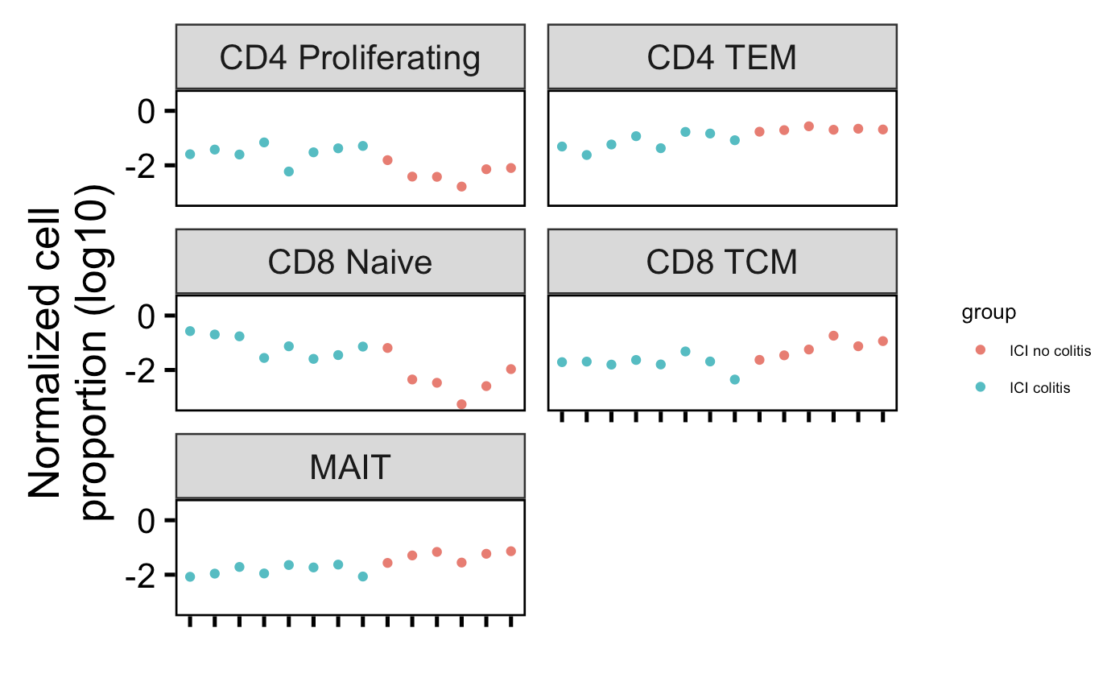
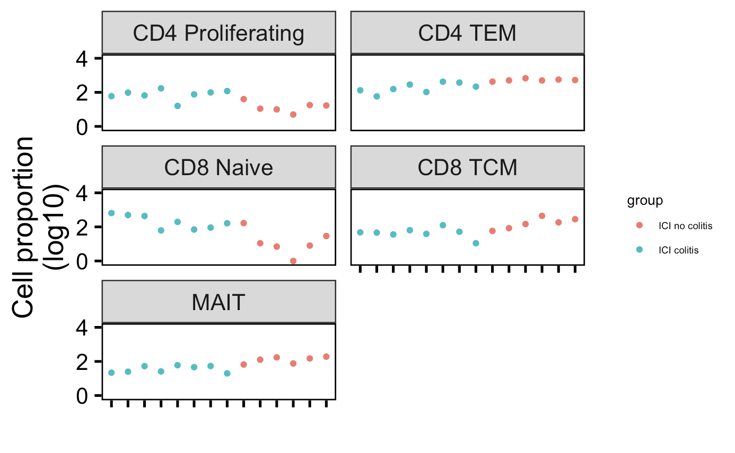
Cell type abundance differences in colitis dataset do not seem to be driven by single/few patients
Normalized by clonotype depth
Downsampled
Notes:
There’s only 1 patient in myocarditis dataset that had colitis and had scRNAseq data… not worth looking into anything with n = 1 I don’t think
# padj normalized by clonotype depth
# CD4 Proliferating: 0.01
# CD4 TEM: 0.004
# CD8 Naive: 0.01
# CD8 TCM: 0.01
# MAITs: 0.004
# padj values downsampled
# CD4 Proliferating: 0.01
# CD4 TEM: 0.004
# CD8 Naive: 0.02
# CD8 TCM: 0.01
# MAITs: 0.004

Slide 5
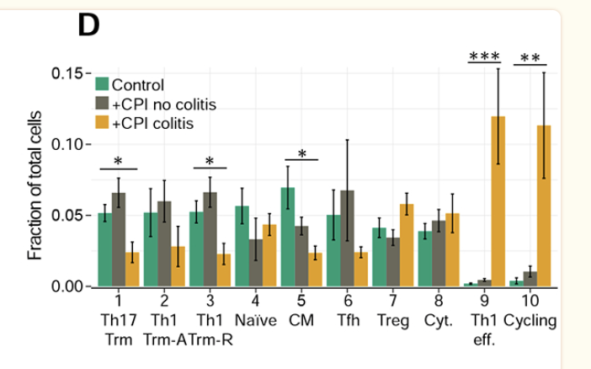
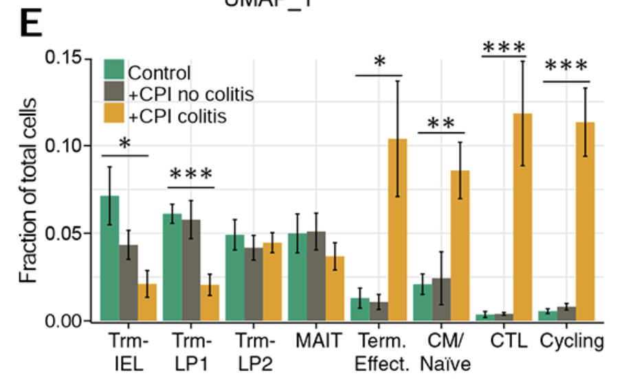
My mining and colitis paper cell type abundance results ~mostly recapitulate, although my reference mapping didn’t yield Trms
CD4s
CD8s
Fewer CD4 TCM in colitis irAE group which I didn’t see (I saw fewer CD4 TEM)
Higher cycling/proliferating in irAE group does recapitulate
Group CD8 TCM/Naïve that I see having opposite abundance trends…
fewer MAITs in irAE group trend does recapitulate thoug (although not significant for them), and higher cycling/proliferating trend in irAE group (although not significant for me)
Notes:
My impression is that their cell typing was ~manual based on marker expression

Slide 6
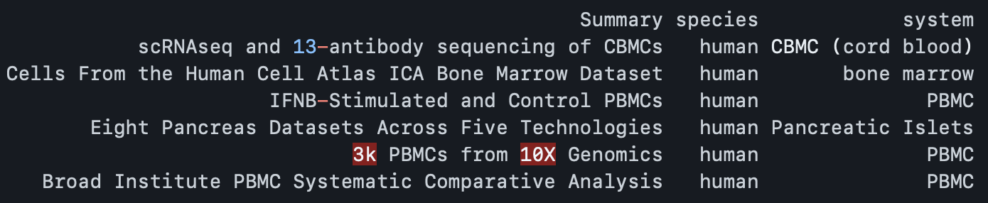
Use of PBMCs for Seurat reference mapping
Notes:
Annotate each query cell based on a set of reference-defined cell states
Project each query cell onto a previously computed UMAP visualization
find anchors between reference and query
transfer cell type labels and protein data from the reference to the query. Additionally, we project the query data onto the UMAP structure of the reference

Slide 7
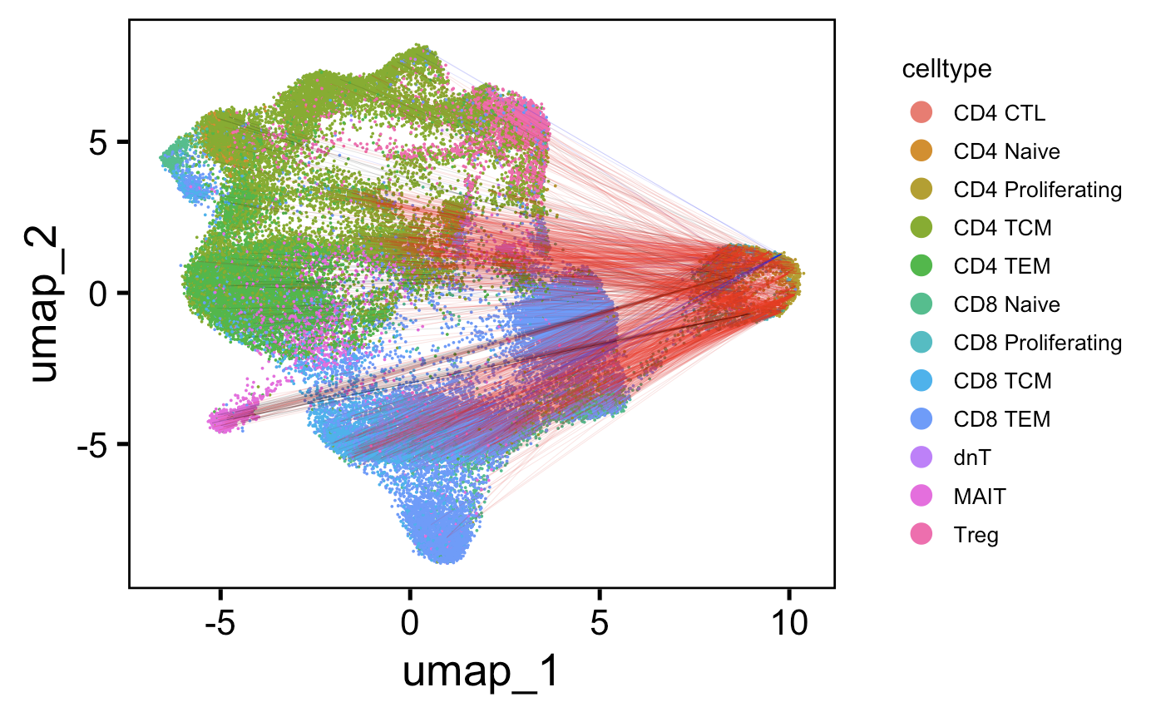
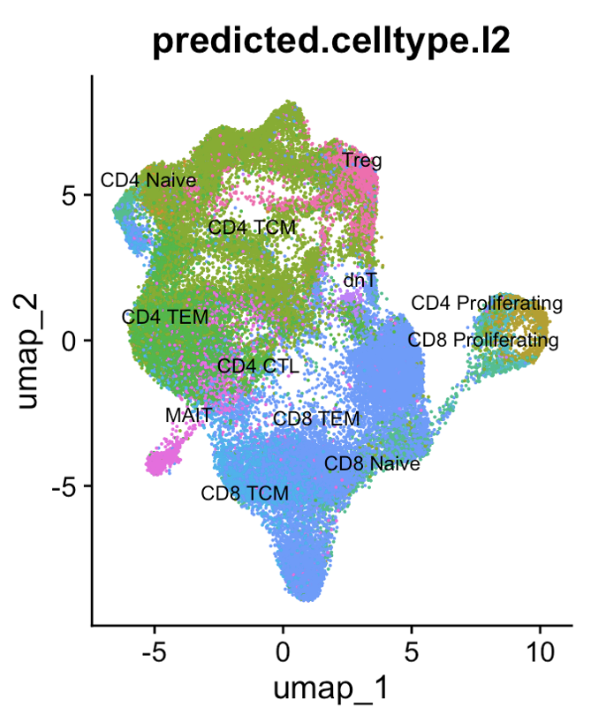
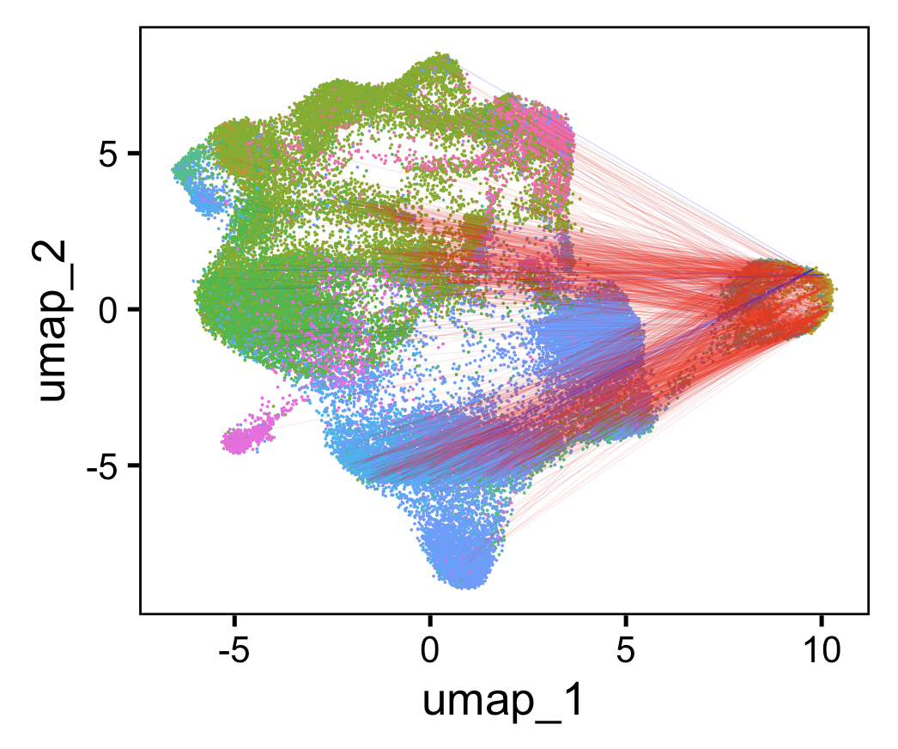
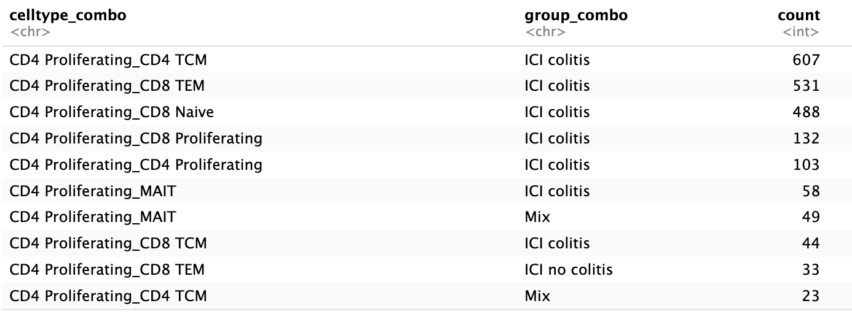
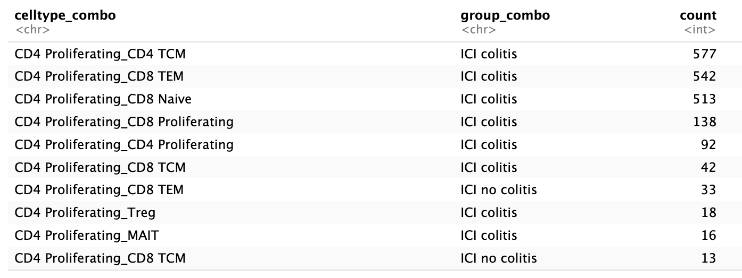
In colitis dataset, junctions of CD4 proliferating cells mostly shared with CD4 TCM, CD8 TEM, CD8 Naïve cells
Line color:
Colitis irAE
No colitis irAE
Mix
TRA
TRB
Chose 1500 random (ICI) linkages
to plot (memory limit)
Notes:
Linkages mostly intra-ICI colitis because this cell type more abundant in that group

Slide 8
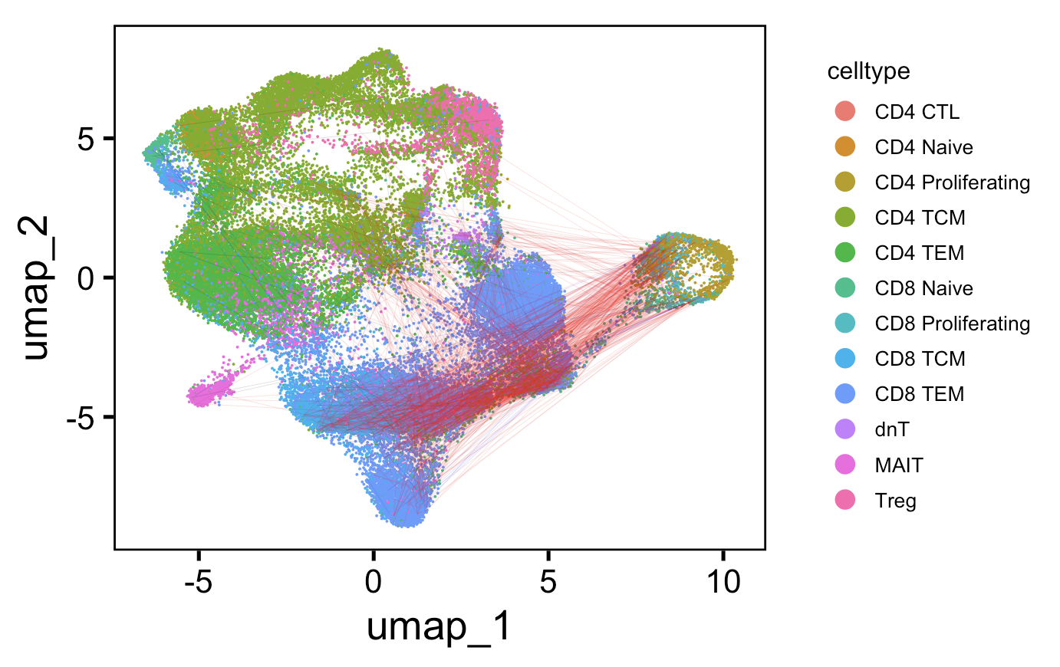
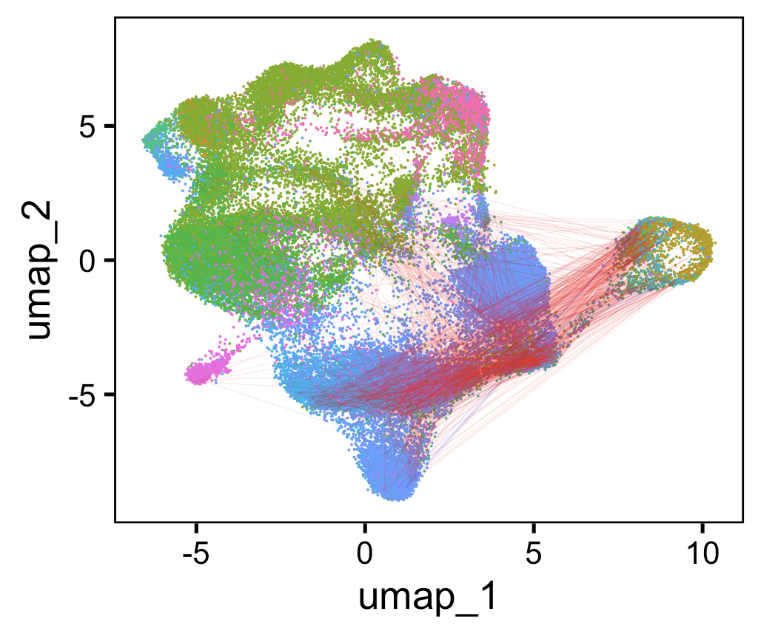
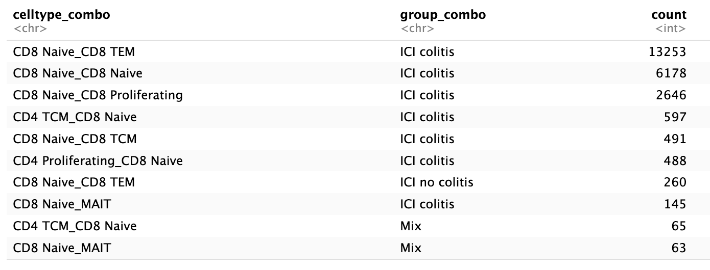
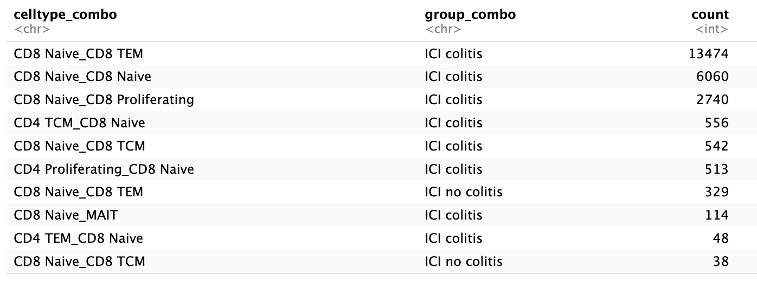
In colitis dataset, junctions of CD8 naive cells mostly shared with CD8 TEMs, themselves, CD8 proliferating cells
Line color:
Colitis irAE
No colitis irAE
Mix
TRA
TRB
Chose 1500 random (ICI) linkages
to plot (memory limit)
Notes:
Linkages mostly intra-ICI colitis because this cell type more abundant in that group

Slide 9
Convergence methods
Both types of convergence
Intrapatient convergence
Colitis dataset: filter out no ICI group
Group by cdr3 AA sequence
Count n_distinct cdr3 NT seqs per CDR3 AA
Ungroup
Group by CDR3 AA and irAE group (to deal with cases where CDR3 in both groups)
Slice(1)
Perform wilcox test on distributions of CDR3 NT seqs/CDR3 AA for 2 irAE groups
To plot, normalize each irAE group by sum of counts, transform y-axis
Group by cdr3 AA sequence & patient ID
Count n_distinct cdr3 NT seqs per CDR3 AA
Slice(1)
Perform wilcox test on distributions of CDR3 NT seqs/CDR3 AA for 2 irAE groups
To plot, normalize each irAE group by sum of counts, transform y-axis
Notes:
don’t want to group by patient instead for step 5 because then double counting CDR3s?

Slide 10
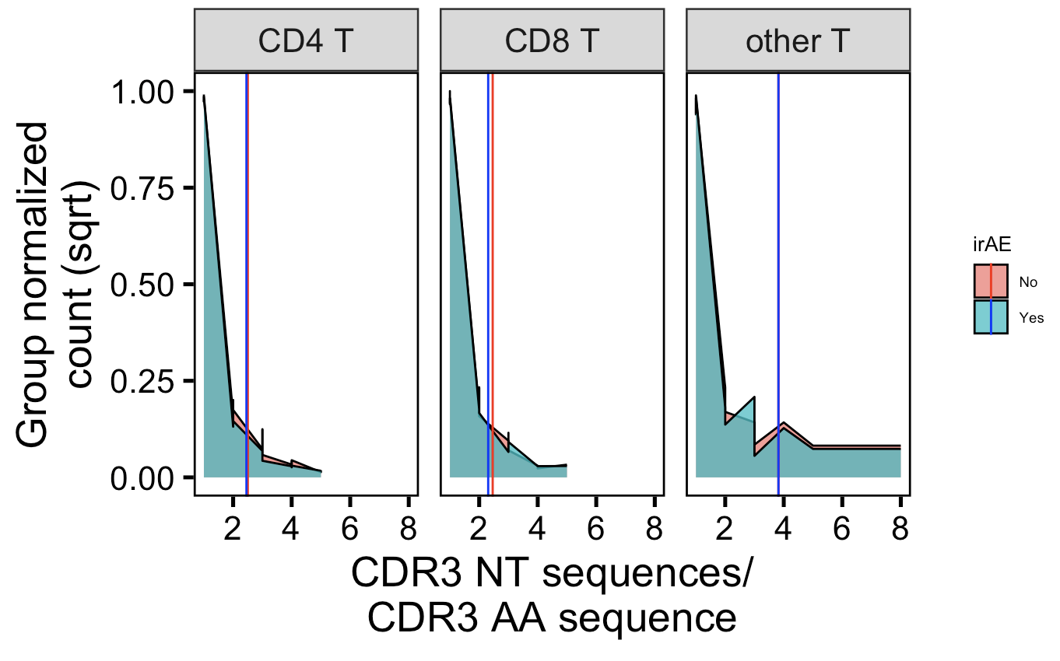
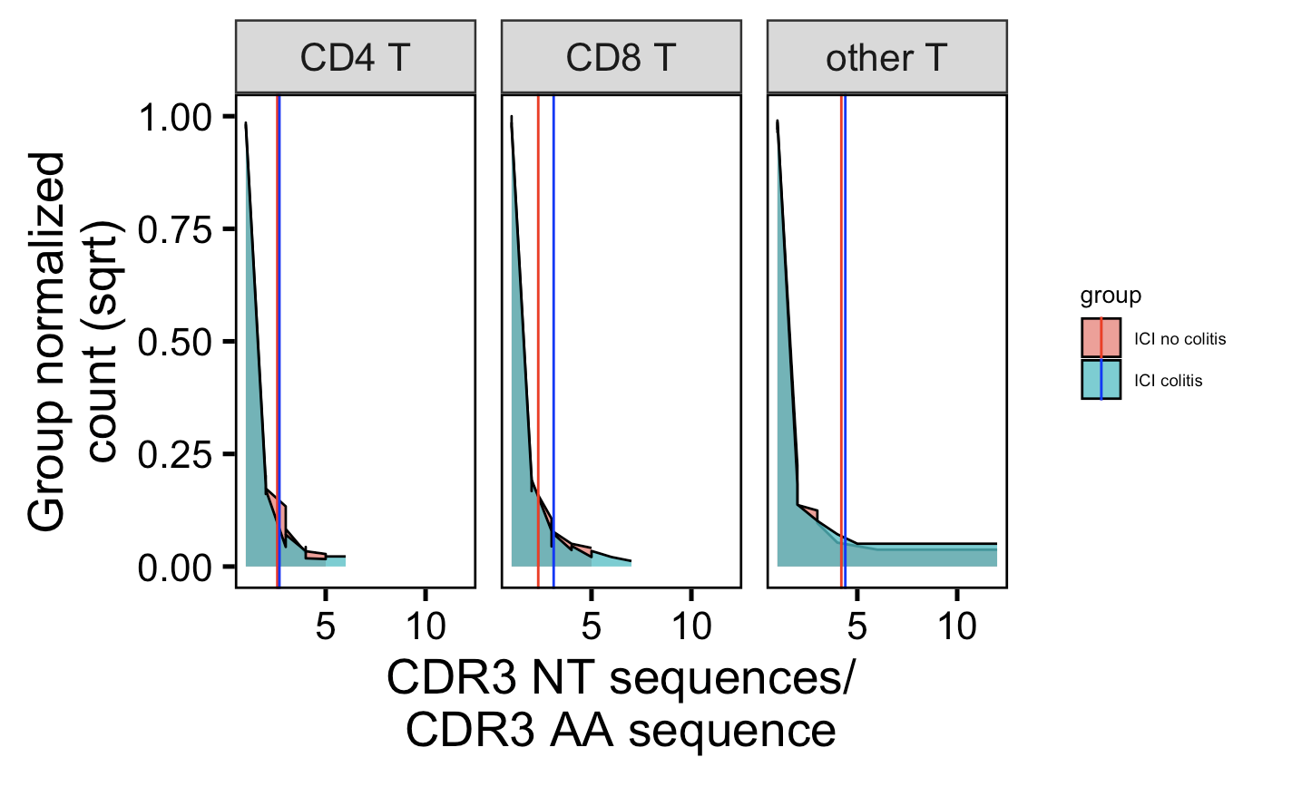
Intra- & inter-patient convergence by irAE group has opposite trends in CD4 Ts from 2 datasets
Myocarditis dataset
Colitis dataset
**
****
vertical lines are means
Wilcox rank sum test: ****; padj < 1e-4, **; padj <1e-2, *; padj <0.05
Notes:
Myo # CD4 T: 0.00062 (padj)
Colitis # CD4 T: 2e-6 (padj)
Ask Peter if this is what he envisioned for me doing for this data? Offer to perform on his data

Slide 11
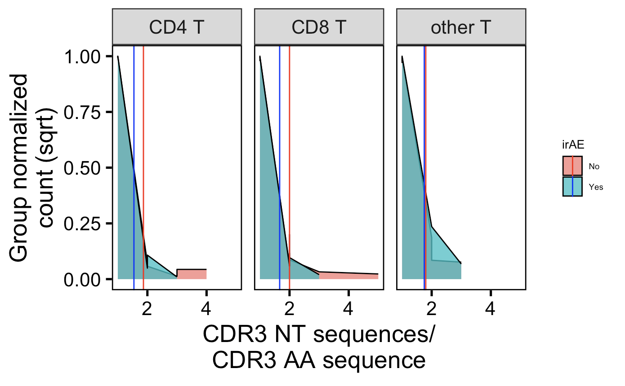
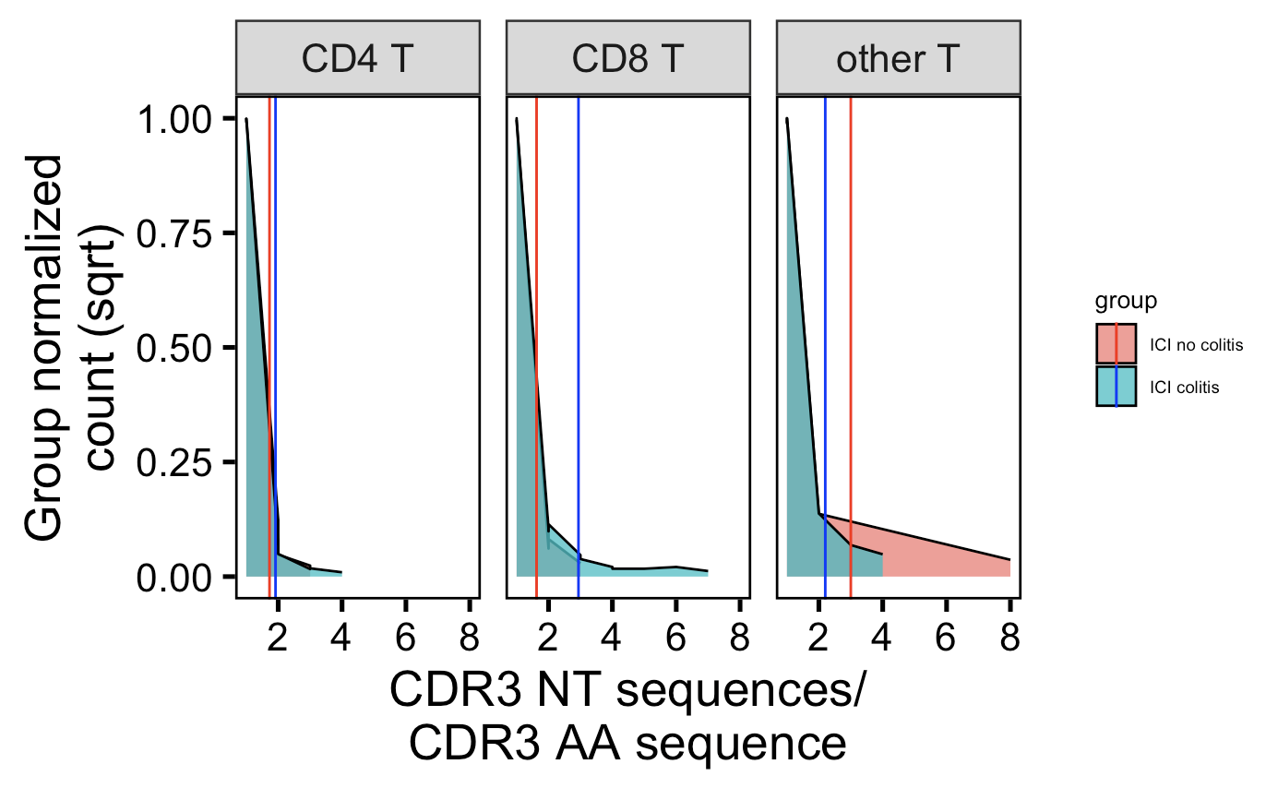
Intrapatient convergence higher in colitis irAE group in CD8 Ts
Myocarditis dataset
Colitis dataset
*
vertical lines are means
Wilcox rank sum test: ****; padj < 1e-4, **; padj <1e-2, *; padj <0.05
Notes:
Myo # CD4 T: 0.00062 (padj)
Colitis # CD4 T: 2e-6 (padj)
Ask Peter if this is what he envisioned for me doing for this data? Offer to perform on his data

Slide 12
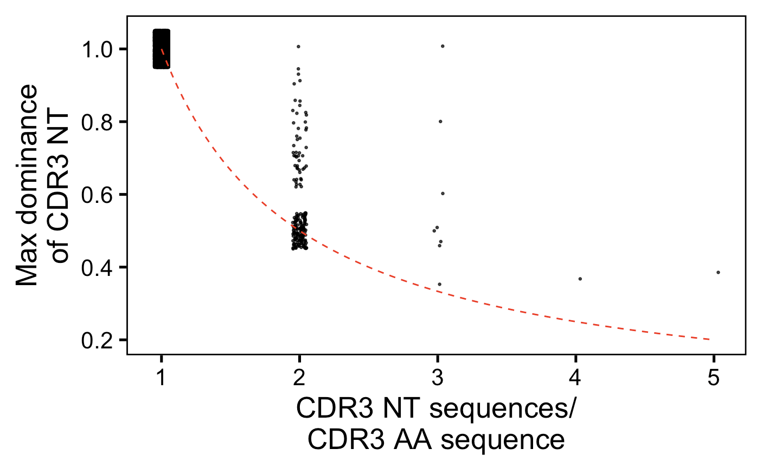
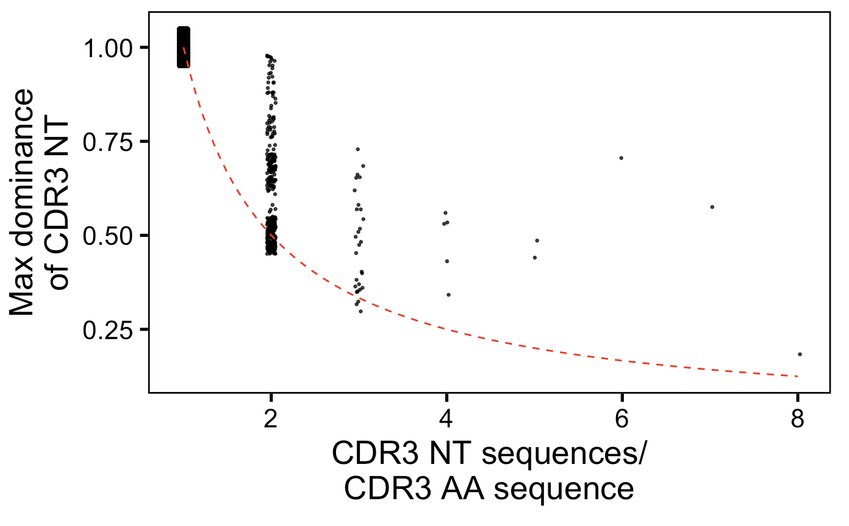
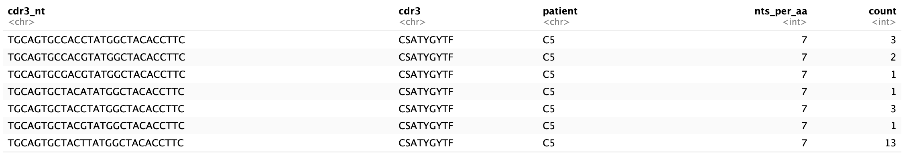
Contribution of sequencing errors to intrapatient “convergence”
Myocarditis dataset
Colitis dataset
(7, 13/sum(count)) is one
example data point above

Slide 13
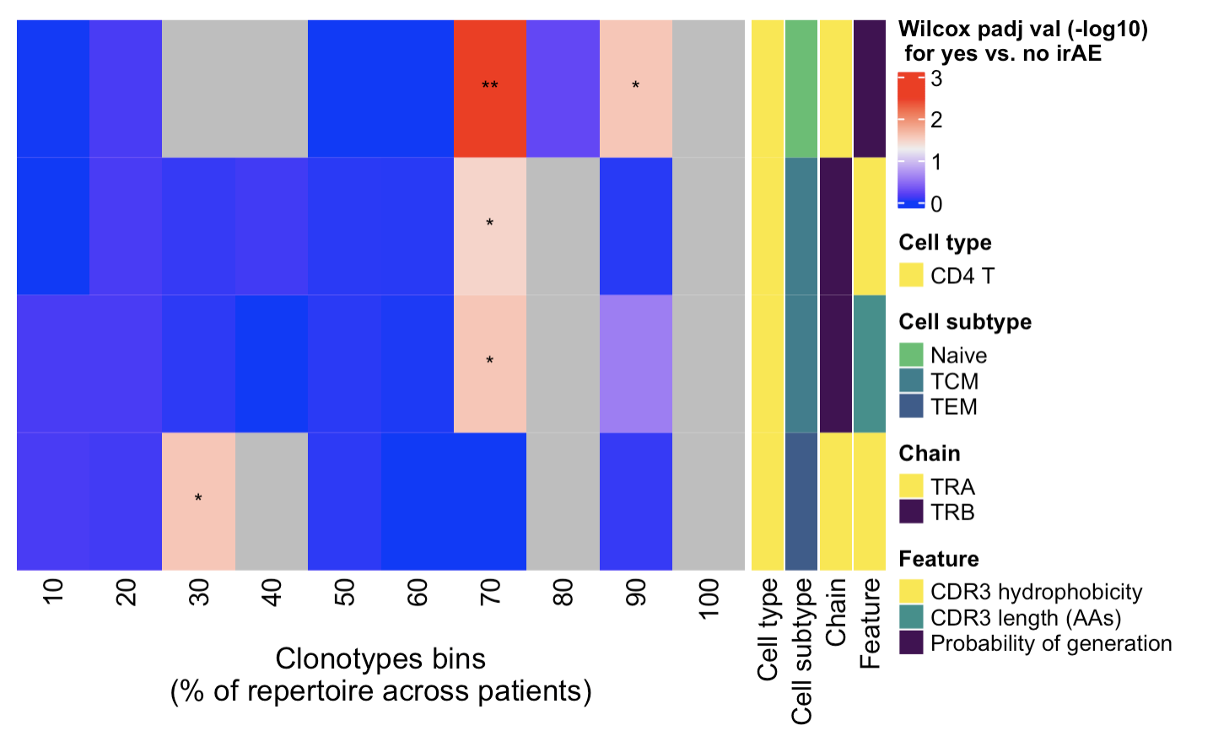
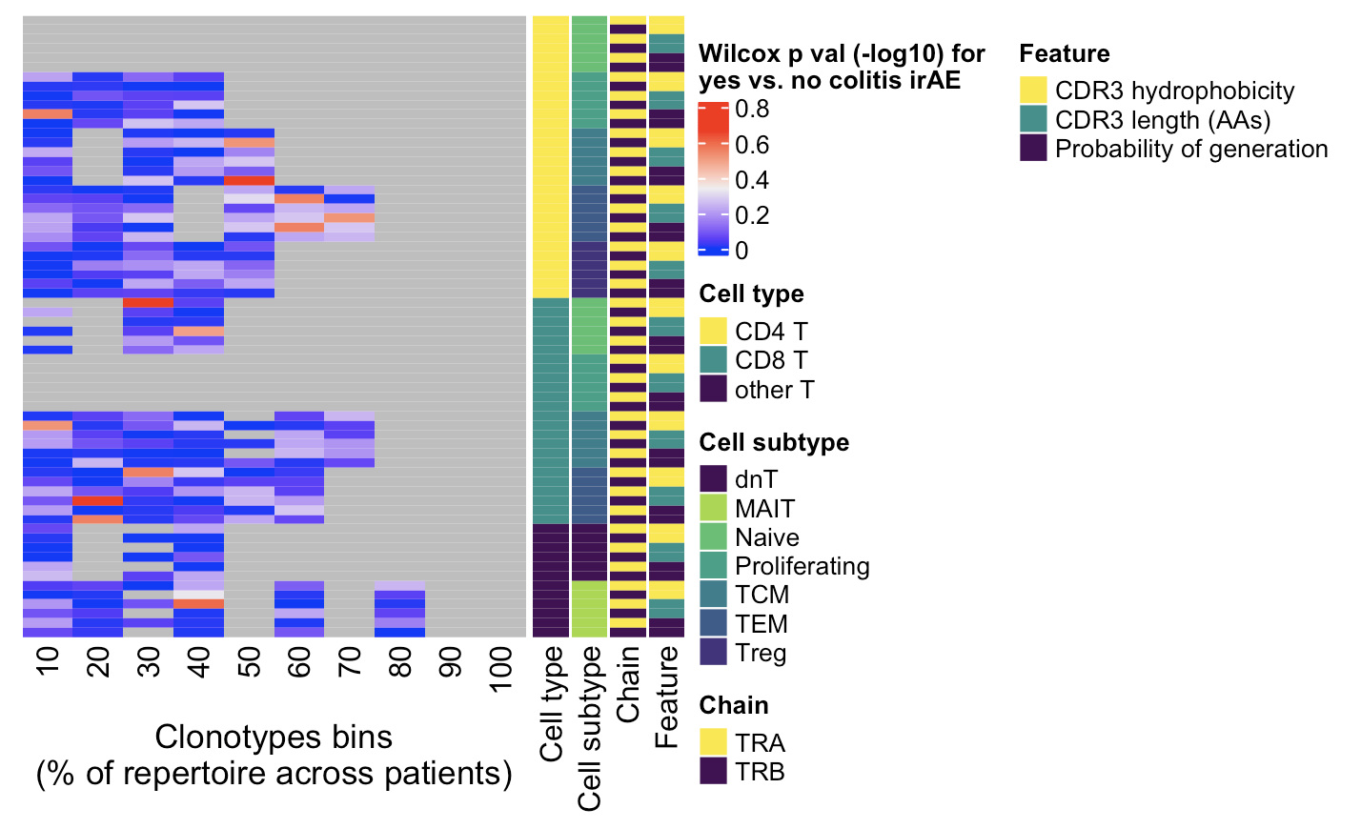
Given ability of rare clonotypes to drive disease, also investigated non-cumulative clonotype heatmaps
Myocarditis dataset
Colitis dataset
adj
← Increasing clonotype abundance
← Increasing clonotype abundance
**, padj <1e-2; *; padj <0.05
Notes:
Clonotypes here for both heatmaps ordered by counts normalized by clonotype depth
# CD4 Naive TRB hydrophobicity 70, 90%
# CD4 TCM TRB hycrophobicity 70%
# CD4 TCM TRB CDR3 length 70%
# CD4 TEM TRA hydrophobicity 30%

Slide 14
Conclusions
Cell type abundance differences in colitis dataset do not seem to be driven by single/few patients, ~mostly recapitulate published results
In colitis dataset, junctions of…
CD4 proliferating cells mostly shared with CD4 TCM, CD8 TEM, CD8 Naïve cells
CD8 naive cells mostly shared with CD8 TEMs, themselves, CD8 proliferating cells
2 datasets have opposite conclusions for CD4 T convergence differences by irAE group, intrapatient convergence higher in irAE colitis group in CD8 Ts
No difference in convergence/publicity between irAE groups for cell types more abundant in colitis irAE tissue (data not shown)
In myocarditis dataset, uncover some feature differences between irAE groups (caveat: only in myocarditis dataset and not recapitulated in downsampled method, so perhaps driven by single/few patients)
rare CD4 Naïve cells’ TRB hydrophobicity
rare CD4 TCMs’ TRB hydrophobicity
rare CD4 TCMs’ TRB CDR3 length
rather highly expanded CD4 TEMs’ TRA hydrophobicity

Slide 15
Next steps
Compute new UMAP after merging reference and query to help identify cells (Trms?) not in reference (PBMCs) present in query (colon tissue), still need to then be able to cell type these cells somehow… If this doesn’t help, reconsider how I’m assigning cell types?
Look at just interpatient convergence (i.e. exclude intrapatient)?
Not sure how to do… subtract intra from intra+inter?
PMC9683788 just looks at intrapatient: “We defined the degeneracy of a TCR protein as the number of distinct clonotypes (defined by DNA sequences) encoding that TCR within one sample. In other words, a degeneracy equal to 1 means non-convergent TCRs, while greater than 1 indicates convergent TCRs”
Not sure about PMC6962348: “TCR convergence was calculated as the aggregate frequency of clones (here defined as unique TCRB nucleotide sequences) sharing a variable gene (excluding allele information) and CDR3 AA sequence with at least one other identified clone.”
Draft SI slides for next weekly meeting
Recapitulate Erin’s figures (ATACseq analysis), which figures?

Slide 16
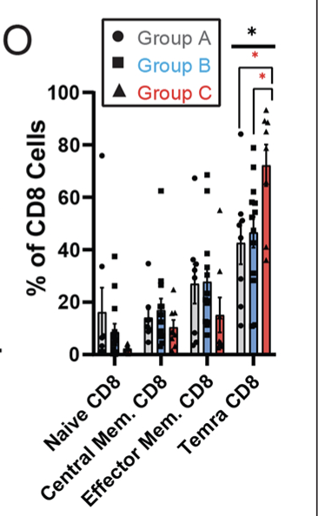
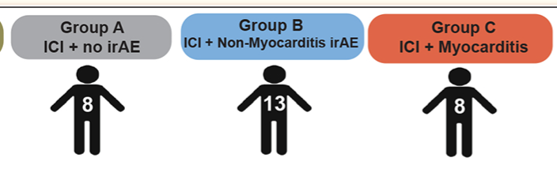
Myocarditis paper cell abundance conclusions
Temra CD8⁺ cells higher in myocarditis irAE group vs. non-myocarditis irAE and control (CyTOF data)
Need to incorporate CyTOF data to pull out Temra cells?

